Slide 1
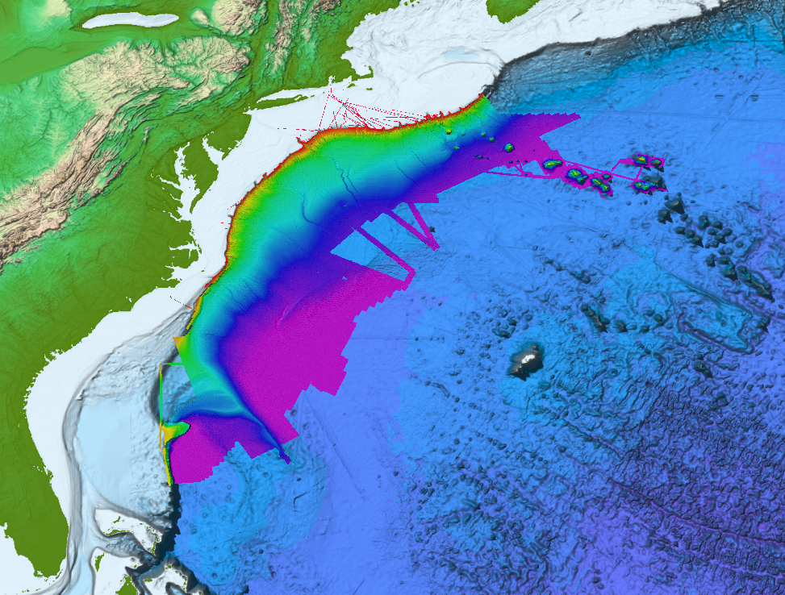
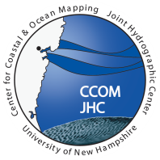
Atlantic Seabed Mapping
A perspective from The United States
Andy Armstrong
The National Oceanic and Atmospheric Administration
and University of New Hampshire
Joint Hydrographic Center

Slide 2
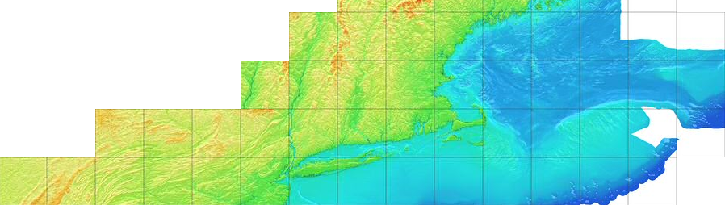
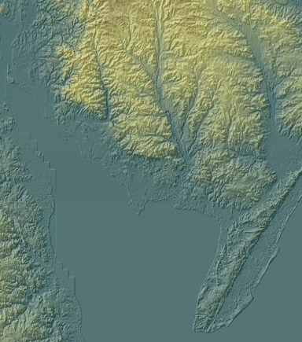
Shelf
Ocean Exploration
Nearshore
Margin
Basin
Extended Continental Shelf Mapping
U.S. Geological Survey
CoNED
Coastal National Elevation Database
NOAA Coastal Relief Model &
Tsunami Inundation Digital Elevation Models
NOAA ETOPO 1 &
Scripps (Sandwell, et al) global marine gravity

Slide 3
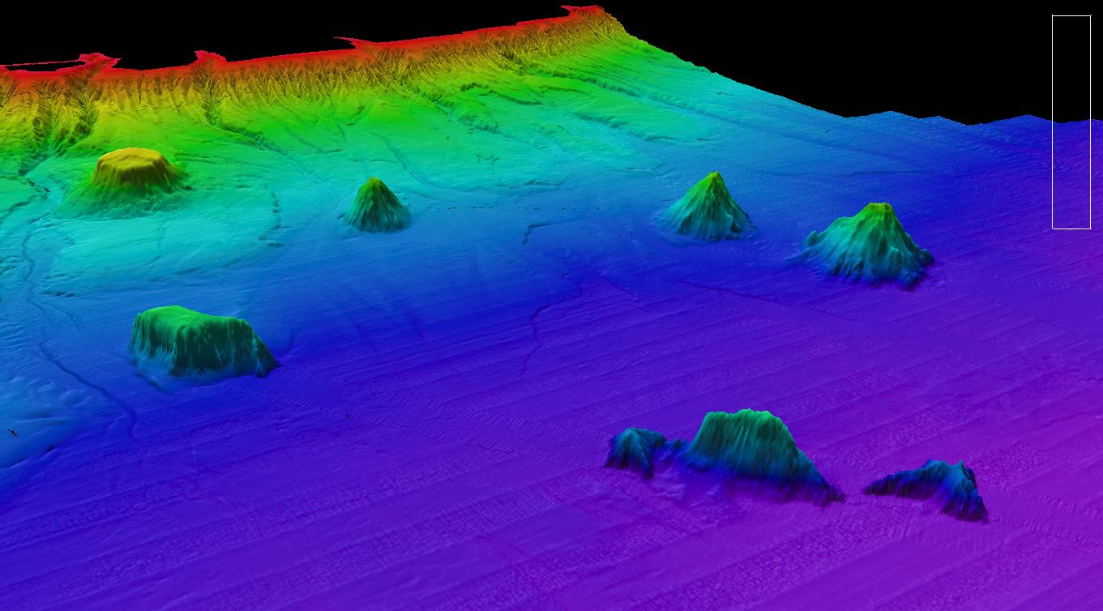
Necessary Actions
Key Issues
Cooperation and Collaboration to Maximize Benefits
  Efficient use of ship time
  Leverage others’ efforts
Adopting/Achieving Common Standards
  Agreed best practices and standards
  Baseline quality and content
  Maintaining expertise
Presenting a Compelling Need
  Dedication of Resources
  Dedication of Assets
Establish and Use a Collaboration Mechanism
Commit to timely free exchange of data
Adopt a best practices document
Promote uncertainty and metadata standards
  Bathymetry, backscatter, water column data specifications
Adopt a standard habitat scheme (like CMECS)
Encourage common training and competence standards
Demonstrate value
Establish Priorities

