Slide 1
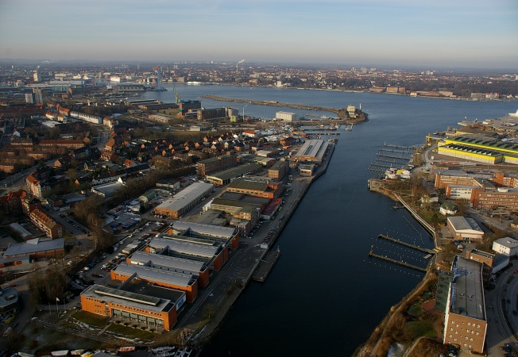
Prof. Colin Devey
Helmholtz Centre for Ocean Research Kiel
Geomar
ca. 800 employees
Role of ocean in climate change
Anthropogenic impact on marine ecosystems
Marine resources
Plate tectonics and natural hazards
Mapping the deep Atlantic seafloor
Most efforts are project-based
Coverage therefore patchy, often repeat returns
Deep ocean practically unsurveyed at resolution <1km

Slide 2
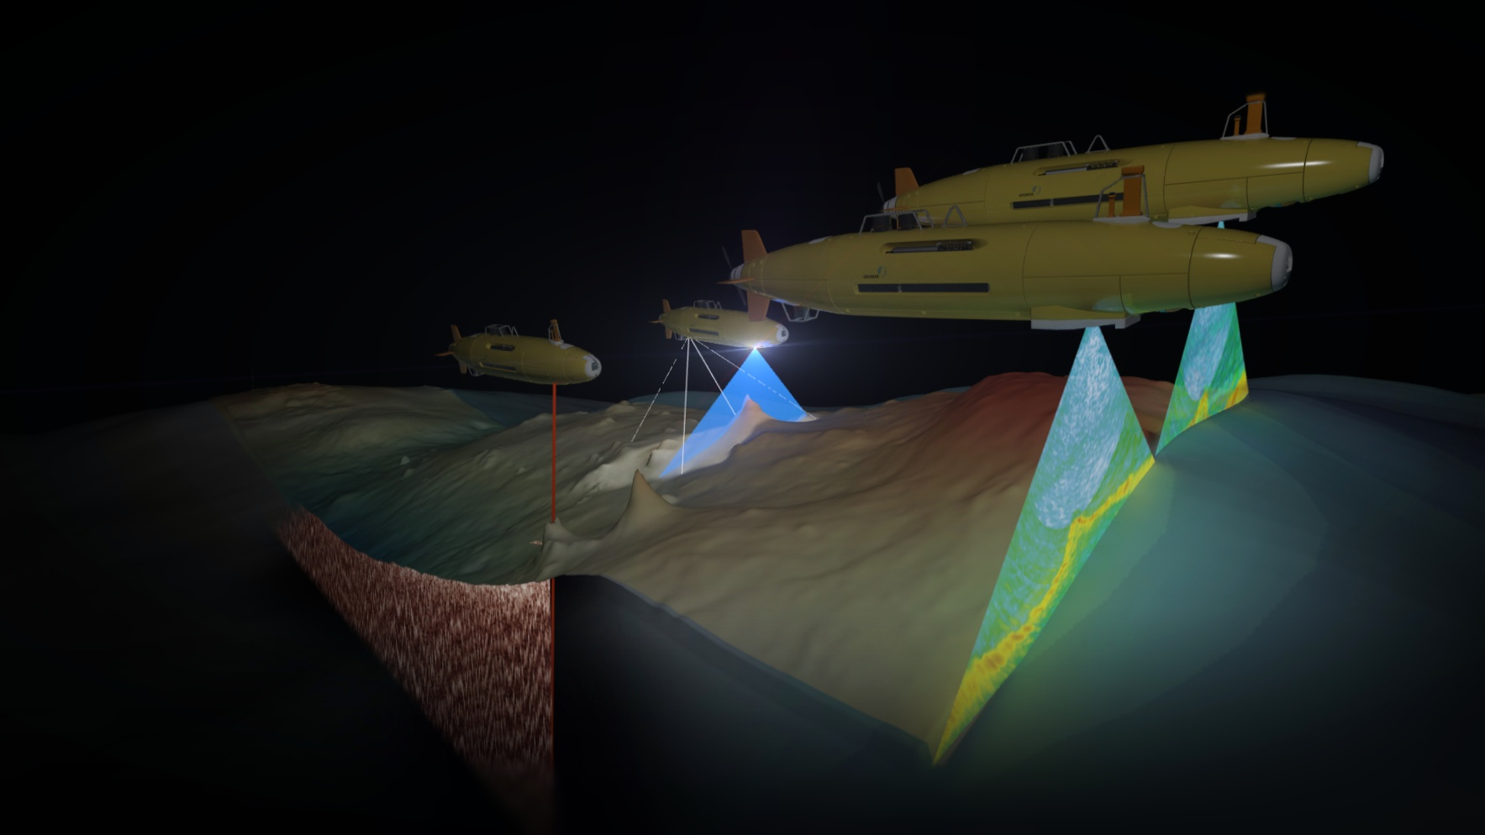
To really map the deep Atlantic we need to:
Key Priorities in Atlantic Seafloor Mapping
Massively increase mapping efforts: The deep North Atlantic is 5000x5000km large. Using a single ship to map this will take 40 years (no port calls, no bad weather). So we need to make autonomous mapping a reality (technically and legally).
Use deep-submergence mapping for key areas: At some point a ship 4000m above the seafloor cannot “see” the necessary detail. Ship-supported AUV fleet mapping is then most efficient.
Decouple data acquisition from data interpretation: Remove intellectual rights constraints from mapping data, make it freely accessible immediately (particle physics model). Project-based mapping will never map the whole ocean.

Slide 3
Steps to address these priorities:
Implementation Measures
Acquire (€€) and run (€€) a fleet of surface autonomous mapping vehicles: Power supply and data retrieval are key technical issues, legal status in marine traffic also problematic?
Establish a central data repository for data from this fleet: ARGO or CERN provide good models for this. Key aspects are data quality control (trained people), open-access (public funding) and geography-based data retrieval (based on where and not when of acquisition).
Establish one common interface for data visualization and access: Organize a user-workshop (academics, industry, spatial planners) to define which of the interfaces (GeoMapApp (LDEO), EModNET (EU) etc.) is most used and most practical for the AtlasAtlantic

