Slide 1
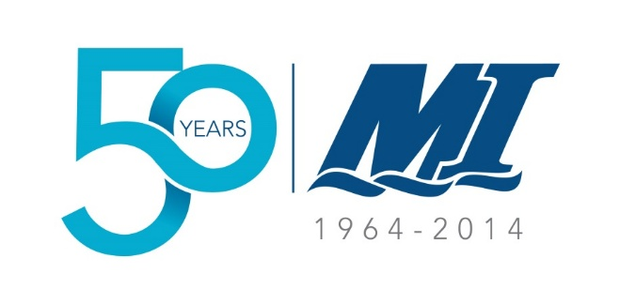
S4: NW Atlantic Ocean Observation, Prediction, Forecasting - What is the current state of ocean observation – what are the critical gaps?
Current state: Atlantic Zone Monitoring Program; Environment Canada buoy program; CHS tide gauges; Radarsat2; HMCS Trinity; Argo floats (100/3500); Ocean Tracking Network; International Ice Patrol / PAL; NOAA volunteer observing ships; SmartBay / SmartAtlantic Alliance
Critical gaps: Baffin Bay / Labrador Shelf; shallow coastal / deep ocean; icebergs (size, shape and movements); water column (temperature, salinity, current strength and direction); lack of coordination / sporadic efforts; science/industry ‘divide’
Randy Gillespie, M.Sc., P.Geo., Centre for Applied Ocean Technology

Slide 2
S4: NW Atlantic Ocean Observation, Prediction, Forecasting - What do mariners and modelers need from seabed mapping?
Water depth
Seabed ‘type’ (mud, sand, gravel, rock, etc.) and morphology (ripples, sand waves, iceberg scour, etc.)
Engineering (geotechnical) properties (‘hard pan’, shallow gas, etc.)
Randy Gillespie, M.Sc., P.Geo., Centre for Applied Ocean Technology

Slide 3

S4: NW Atlantic Ocean Observation, Prediction, Forecasting - How can the needs be addressed?
Volunteer observing ships (vessels of opportunity doing ocean observation (VOODOO)) – fishing fleet in particular
New tools / techniques (shallow water mapping; iceberg measurement; geophysical – geotechnical correlation; broad scale water column monitoring)
Get with the program – “Collect data once; maintain closest to source; use many times” (GSDI/GEOSS)
Randy Gillespie, M.Sc., P.Geo., Centre for Applied Ocean Technology

