Slide 1
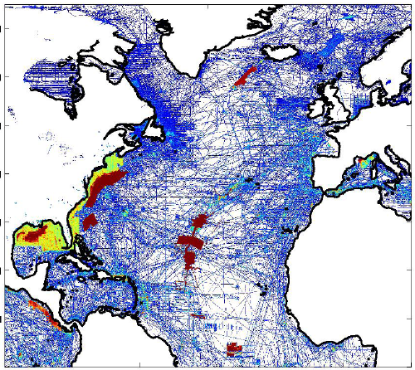
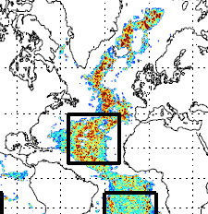
Aligning Mapping and Ocean Observations:
Status
Science alignments not widely appreciated in obs, modeling and mapping communities
Topo roughness -> mixing -> heat transport -> climate (Jayne et al 2004)
Ocean climate -> ecosystem change -> biogeography
Barriers to utilization of new bathymetry in models
Global models not high enough resolution to ingest new bathy
Modelers may need a single file with statistical properties
Ship time not well coordinated across North Atlantic
Most mapping inside national EEZ or ECS claims
Obs coordination from PI access to ships
Timko et al in progress
LCDR Richard E. Hester Jr., NOAA, Research Platform Manager
Galway Statement Implementation – Atlantic Seabed Mapping Dublin December 02, 2014

Slide 2
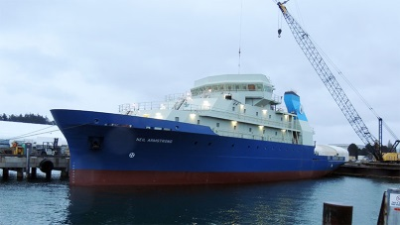
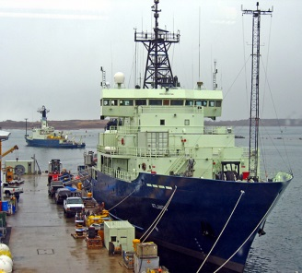
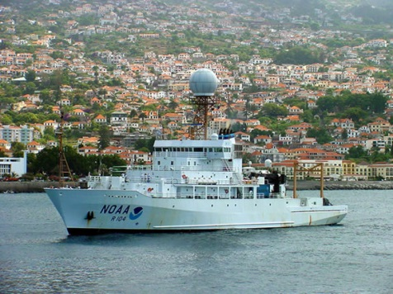
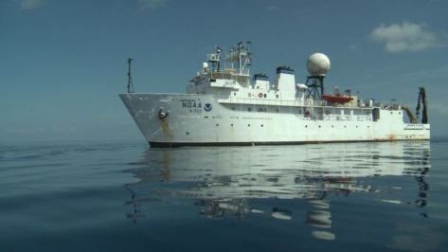
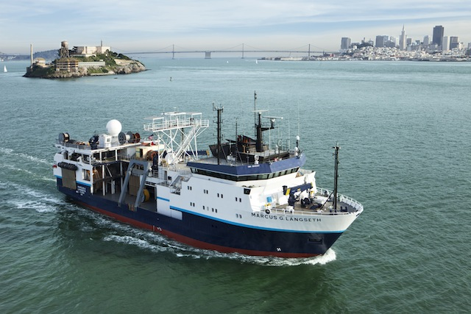
Aligning Mapping and Ocean Observations:
Key Issues
Raising awareness and valuation of linkages between mapping and ocean obs communities
Relative impact roughness vs model resolution
Clarify genetic connectivity via biogeography
Utility of global or large regional bathymetric products for ocean modeling
single data file
statistical extrapolations
Limited number of ships capable and available
US: Ron Brown (FY17-18+), Okeanos Explorer (FY17-18+), Atlantis, Armstrong, Langseth
Unclear if policy constraints for some platforms
LCDR Richard E. Hester Jr., NOAA, Research Platform Manager
Galway Statement Implementation – Atlantic Seabed Mapping Dublin December 02, 2014

Slide 3
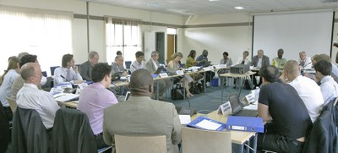
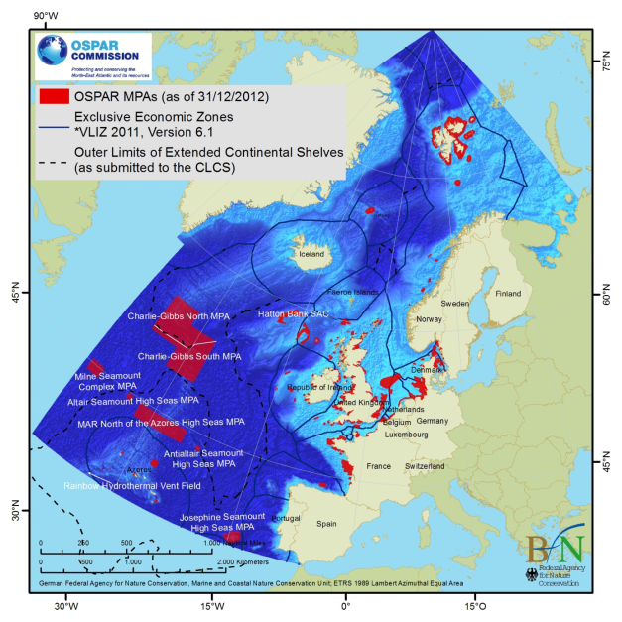
Aligning Mapping and Ocean Observations:
Implementation Measures
Ongoing communications on the priority of model dissipation and topographic roughness.
Investigate incentives, standards, open data exchange to yield intermediate bathymetric product for modelers.
Ships: 1) PI’s & managers prioritize projects that jointly accomplish mapping, obs, modeling objectives, 2) Regular interaction of ship schedulers, 3) Policy development, international exchanges ship time
Consider test case on mid-Atlantic ridge outside EEZ’s and ECS claims. Include mapping, ROV, data standards and exchanges, obs, modeling objectives.
OSPAR Commission 2012
LCDR Richard E. Hester Jr., NOAA, Research Platform Manager
Galway Statement Implementation – Atlantic Seabed Mapping Dublin December 02, 2014

