Slide 1
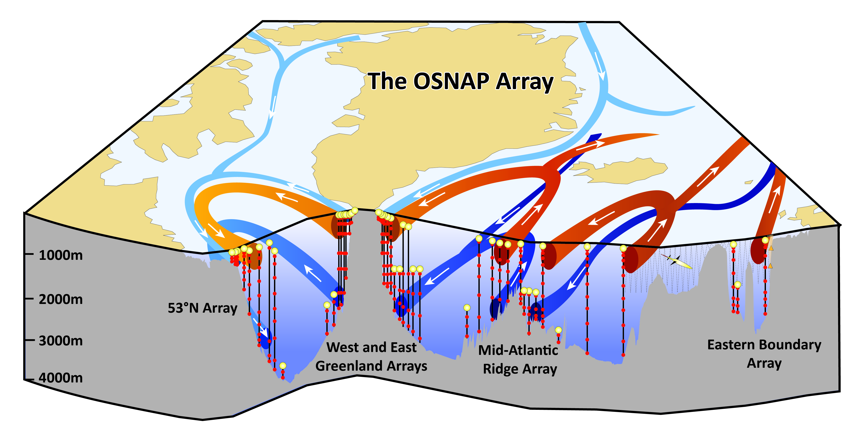
Overturning in the Subpolar North Atlantic Programme (OSNAP)
Presented by Penny Holliday, NOC, Southampton, UK
USA, UK, Canada, France, Germany, Netherlands & China
Four years (2014-18)
“Pilot project”; aim is to design optimally efficient long-term measuring system
OSNAP: quantify large-scale, low-frequency, full water-column net fluxes of mass, heat and fresh water associated with the meridional overturning circulation
Meridional transport of heat & freshwater has a local, regional and global impact
Most of our knowledge derived from (imperfect) models; need direct measurements
Part of Atlantic Ocean transport observing system

Slide 2
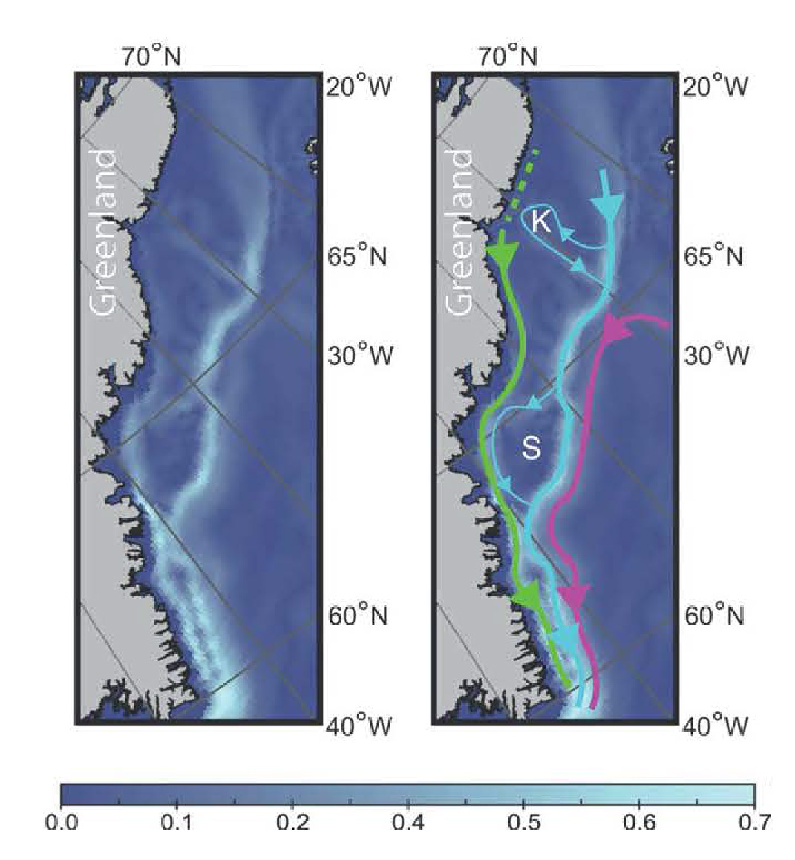
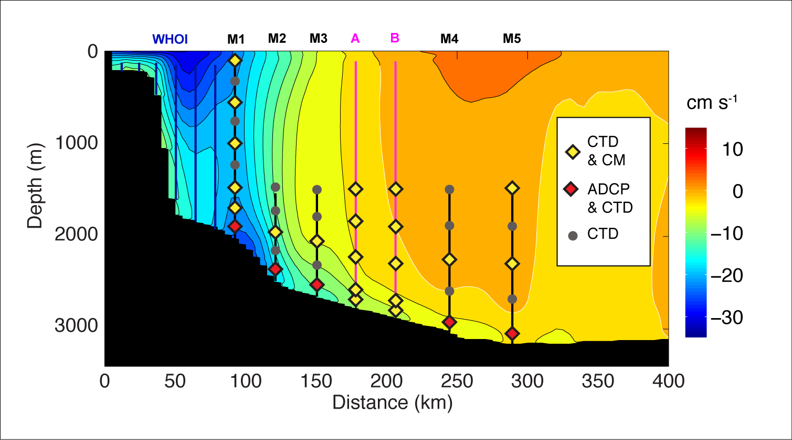
What does Atlantic Ocean Transport Observing Network need from seabed mapping?
A. Global Ocean Circulation Models/Climate Models
Pathways of currents:
depth and gradients (including within a grid cell) are key.
(i) GOCMs need maps at resolution > 1 km model gridscale
=> 100s m scale over large areas, eg Greenland shelf
(climate models lower resolution at the moment…)
Changing the bottom drag coefficent can improve representation of key circulation features in specific locations eg Gulf Stream NW corner, Mediterranean outflow
(ii) Friction and instability: accurate seafloor roughness maps for ocean circulation models
B. Practical information for planning observations
Siting of moorings (10s m scale over specific and small regions)
Now: - approx location determined
- Mooring built for specific depth
- 24 hour swath survey
Better: maps allow precise planning

Slide 3
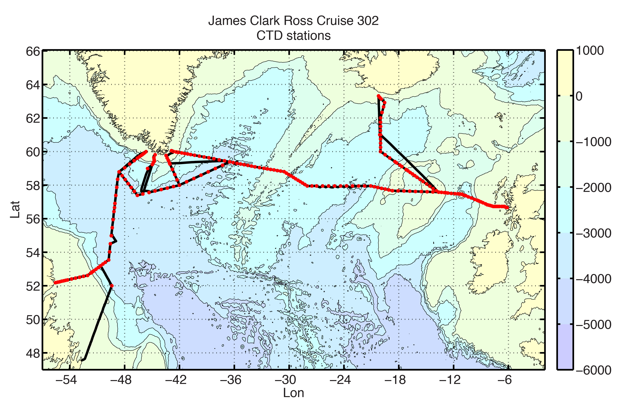
Implementation Measures
Need more data? Use oceanography cruises
as ships of opportunity for multi-beam data
eg OSNAP summer 2014, 6 cruises, 4 ships,
more cruises in 2015,16,18
Many other suitable cruises planned
Need agreed protocols for research ships
(with non-specialist staff) collecting opportunistic multi-beam data.
Plus: centre(s) with resources to process and distribute these data
Work with modellers to identify key locations and to improve parameterisation of boundary layer mixing
Need to know what products modellers want – and they need to know how to apply the data in the models (avoid unintended consequences).

