Slide 1
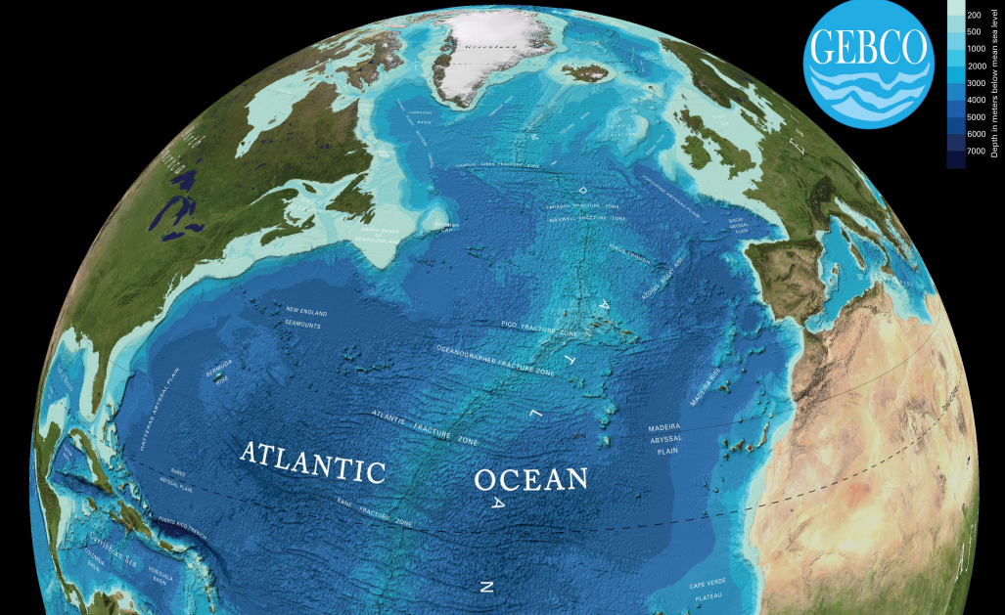


A Global Bathymetry Database
Large Scale Seabed Mapping Data Integration & Exchange - Linking Disparate Datasets
IHO Data Center for Digital Bathymetry
Gebco Data Store
Rolling Deck to Repository (R2R)
Data Access
Data Sharing
Data Standardization
Jennifer Jencks
NOAA’s National Geophysical Data Center
jennifer.jencks@noaa.gov
December 2, 2014

Slide 2
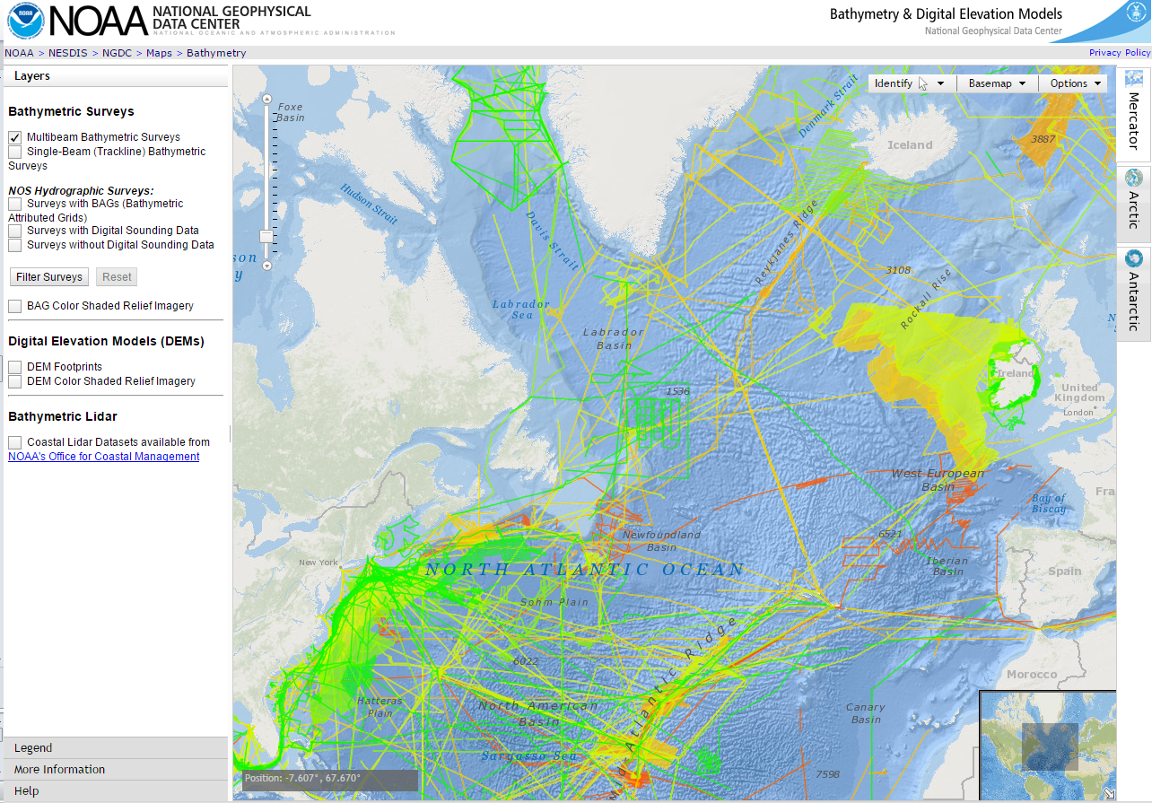
IHO Data Center for Digital Bathymetry
General Bathymetric Chart of the Ocean (GEBCO) Data Store
  Seeks processed and gridded data
  Grid cells flagged with constraint information
  Attributed to source organizations to encourage contributions
  Public (free, open access)
  Two-way access to data and metadata
A repository for bathymetric trackline and gridded data used to produce GEBCO grids
2015 – GEBCO Data Store Layer
Long-term archive and management of bathymetric data
Standard web services for discovery and delivery of data and metadata
Public Access to Continental Shelf Data
Notes:
Improve Data Access & Sharing
- Leverage IHO DCDB web services for discovery and delivery of data and metadata

Slide 3
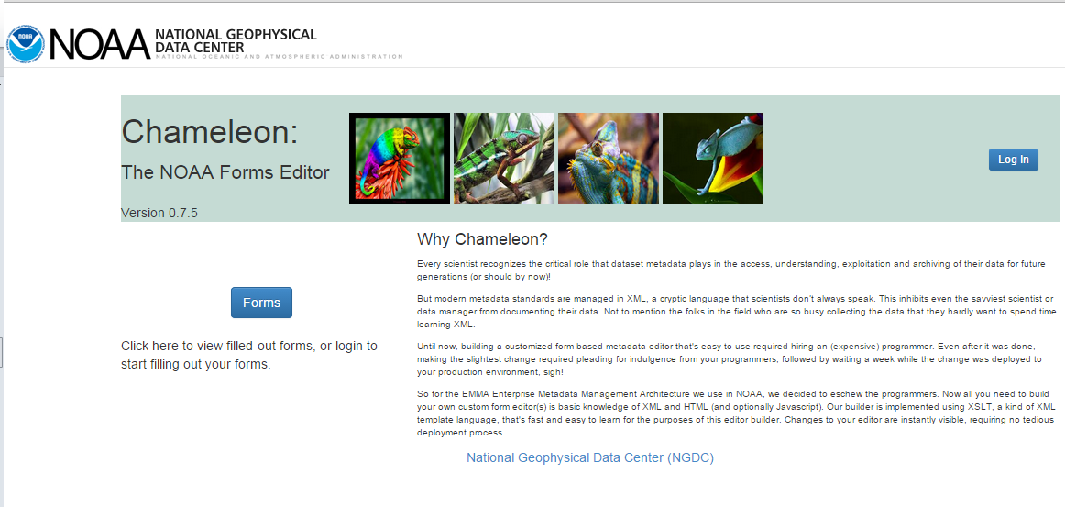
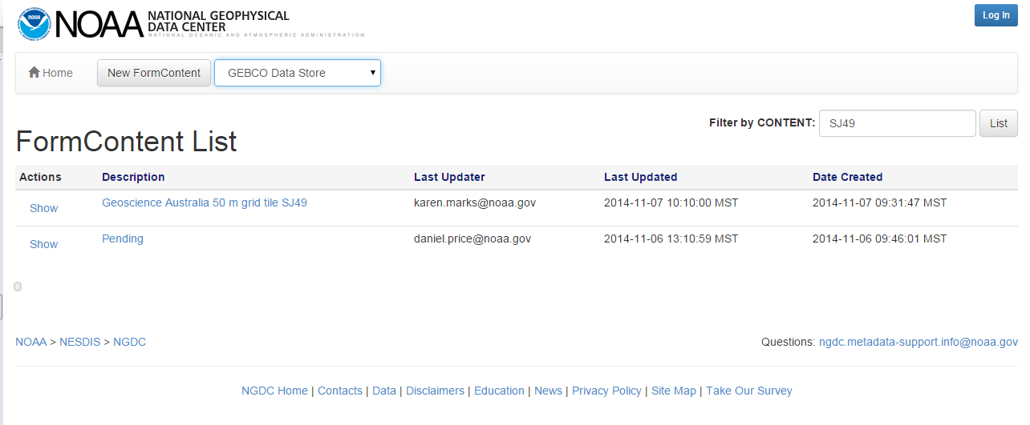
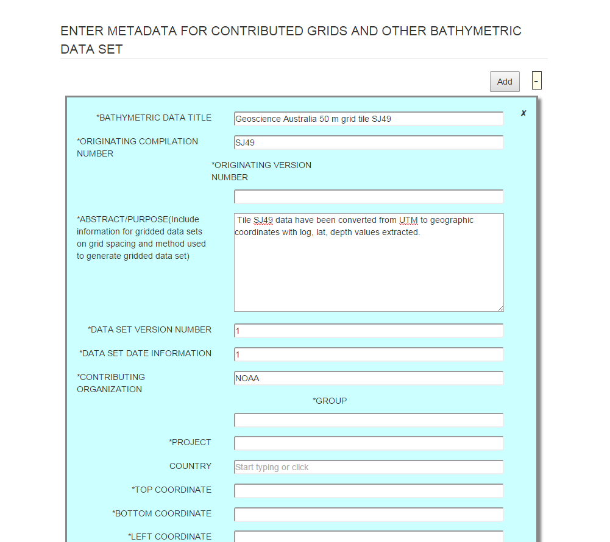
General Bathymetric Chart of the Ocean (GEBCO) Data Store
Spring 2015: Data upload & access
Enables contributors to easily create acceptable metadata and submit data through an HTML form.
Create and submit metadata
Notes:
It is proposed that the existing infrastructure of the DCDB be enhanced to enable it to become a global digital bathymetry data store. This would incorporate upload and download capabilities that are automated. In particular, it would enable pre-qualified data contributors to upload data and metadata at will. Similarly, it would be possible for data and metadata to be extracted from the data store automatically. This may be best achieved using Web Mapping technology. It is important that the data extraction capabilities are automated in order to minimise administrative and operational overheads and to reduce potential exposure to liability for any implied quality judgements about the data by the custodians (IHO). The contents of the data store would, in effect, be available to users on an “at own risk assessment” basis.

Slide 4
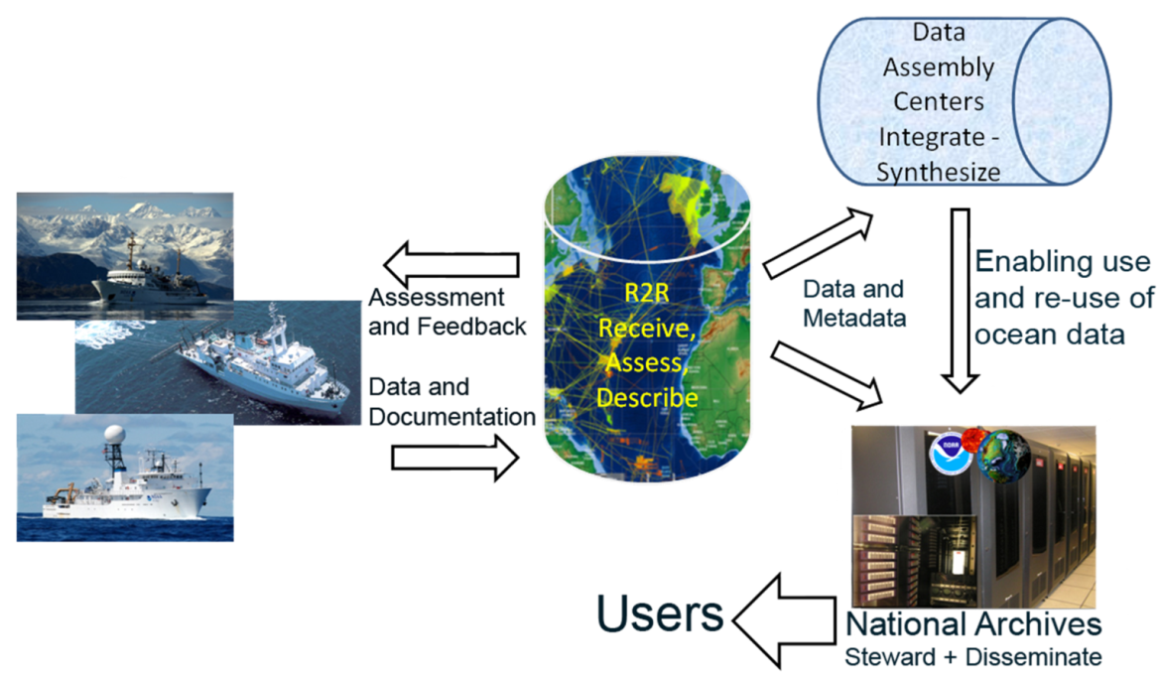
R2R - Rolling Deck to Repository
Integrated Ocean & Coastal Mapping Program
rvdata.us
Integrated Ocean & Coastal Mapping Program
Academic/Government collaboration to automate delivery of data and generation of metadata from ship to processing center to repository (archive)
“Map once, use many times”

Slide 5
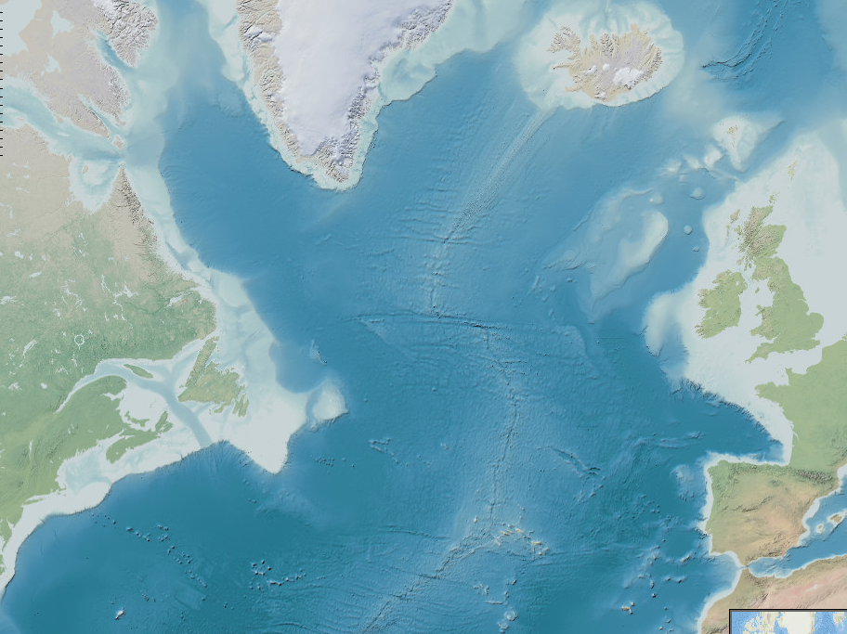
Priority #1: Improve Data Access
IHO DCDB & Gebco Data Store
Priority #2: Improve Data Sharing
Gebco Data Store & R2R
Priority #3: Improve Data Standardization
Gebco Data Store & R2R

