Slide 1
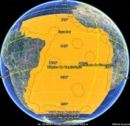
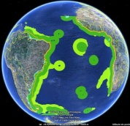
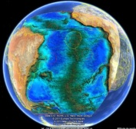
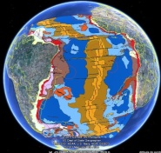
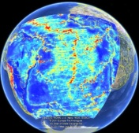
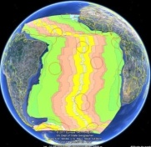
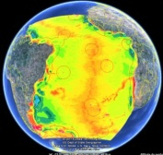
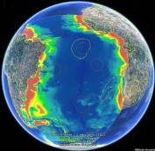
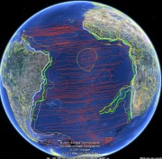
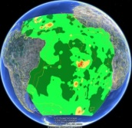
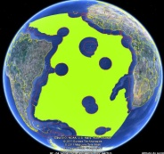
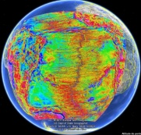
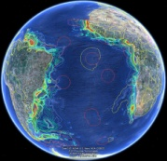
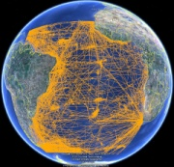
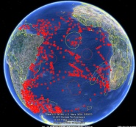

The Galway Statement Implementation
Atlantic Seabed Mapping Workshop
SOUTH AND TROPICAL ATLANTIC DEEP SEA
INTEGRATED RESEARCH PROGRAMMME
Brazilian proposal
Dublin, Ireland
1st and 2nd December 2014
Kaiser Gonçalves de Souza, Oceanis Mineral International
On behalf of the Ministry of Science, Technology and Innovation of Brazil

Slide 2
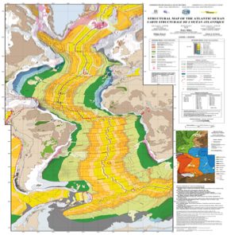
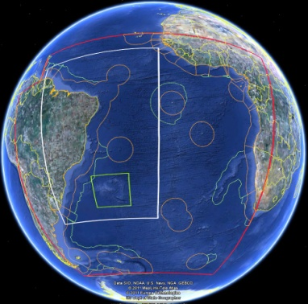

SOUTH AND TROPICAL ATLANTIC DEEP SEA
INTEGRATED RESEARCH PROGRAMMME
Brazilian proposal
Key priorities
Regional and local deep seabed mapping and data integration of areas of scientific, economic and environmental interests;
Integrated oceanographic survey of the deep sea areas of interest, including assessment of the sustainable potential of natural resources;
Integrated study of the regional/local geology and the associated ecosystems to support the sustainable use and conservation of marine ecosystems.

Slide 3
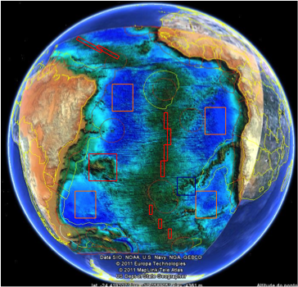
SOUTH AND TROPICAL ATLANTIC DEEP SEA
INTEGRATED RESEARCH PROGRAMMME
Brazilian proposal
Proposed implementation measure
Set a Pilot Project in a selected area;
Establish an expert working group to coordinate activities; and
Organize joint research activities and seabed mapping campaigns.

