Slide 1
Large-scale Seabed Mapping Data Integration
Overcoming data integration challenges, making data relevant and accessible
Alan Stevenson
BGS Marine Geology and Operations Team Leader
Representing:
EMODnet-Geology Project
UK Marine Environment Mapping Programme (MAREMAP)
European Geological Surveys (EuroGeoSurveys)
European Consortium for Ocean Research Drilling (ECORD) agst@bgs.ac.uk

Slide 2
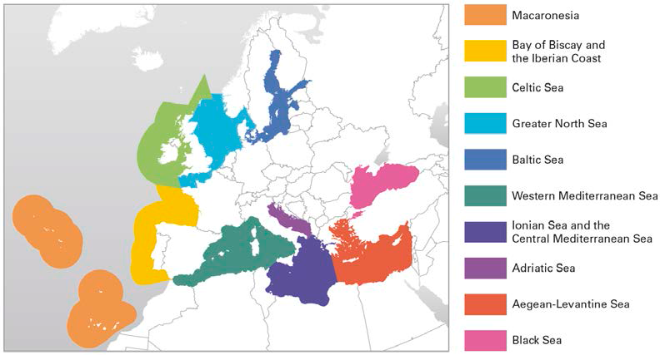
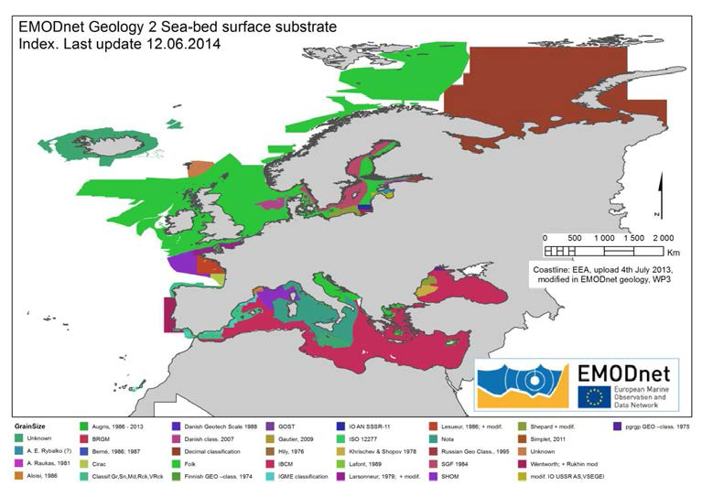
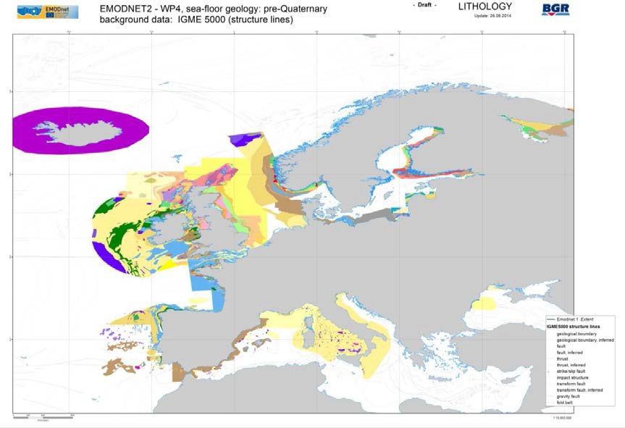
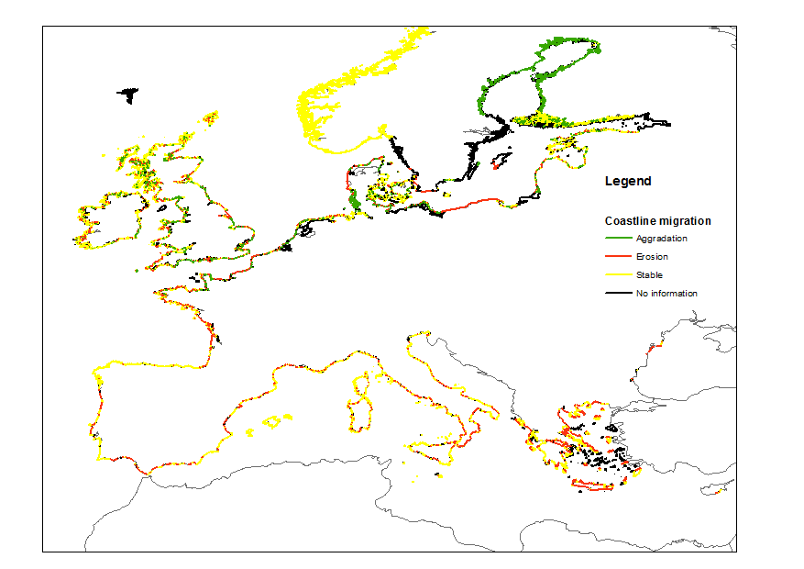

Mapping the geology of Europe’s seabed and coastal zone
Key priorities 1. Identify existing data 2. Integrate and harmonise information if possible
European Regional Seas
Harmonising sea-bed sediment information
Pre-Quaternary geology
Coastal behaviour

Slide 3
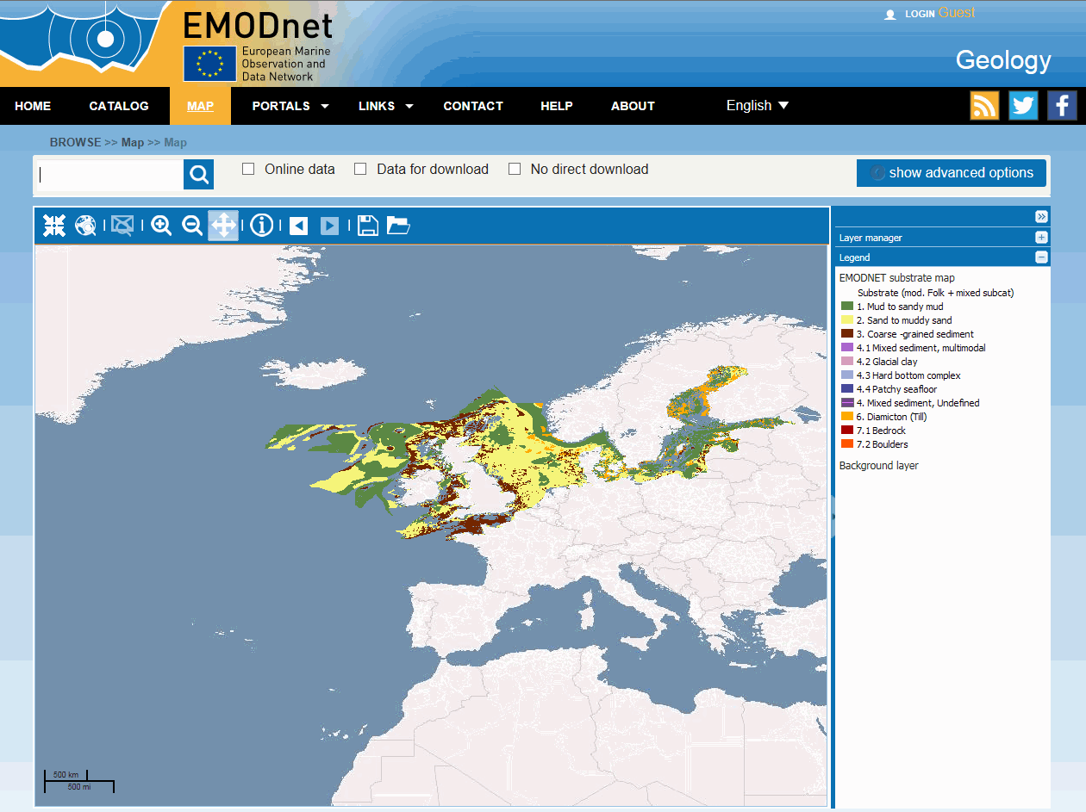
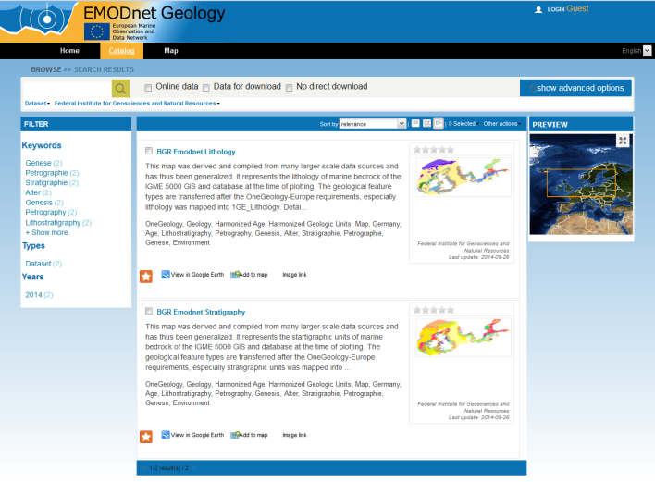
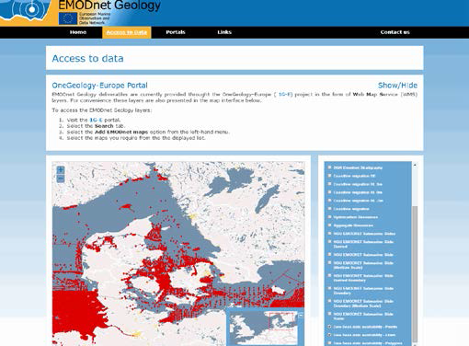

Making data accessible
Key priority 3. Use open source software and standards to manage data catalogues, maps ( Web Map Services (WMS)) and information
Map interface
Catalogues (metadata)
Access to data
Data from third parties (e.g oil and gasfields)

Slide 4
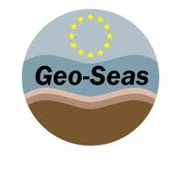


How it works
Portals
Other Portal
Other Interface
INSPIRE Services
How it works
System ingests the WMS services hosted by partners.
Generates images, extracts metadata and provides an interface to the service.
Can include many types of data service.
Provides administrative functionality to manage the catalogue
Discovery
View
Download
Data
Products
(Maps)
Metadata
Catalogues

