Slide 1
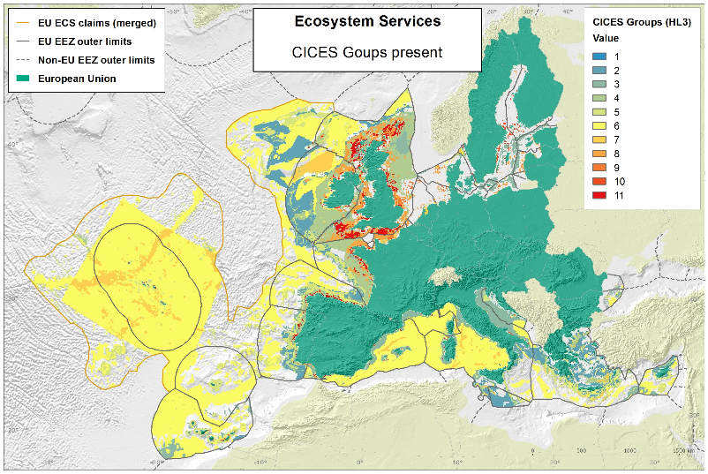
MAIN TOPIC
Joint Research Centre
www.jrc.ec.europa.eu
HARMONIZED ECOSYSTEM SERVICE
MAPS FOR THE NORTH ATLANTIC
FERNANDO TEMPERA, EC-JRC
Ecosystem Services
Mapping and quantifying natural systems’ utilitarian
value to Man facilitates the communication of their
societal goods, benefits and value to the neighbouring communities.
An Ecosystem Service translation of the habitat maps to be produced will highlight benefit hotspots and help planning sustainable ecosystem uses.
Policy Drivers
Convention on Biological Diversity (CBD) - Aichi Target 11
EU Biodiversity Strategy to 2020 - Action 5, Target 2
Marine Strategy Framework Directive
Marine Spatial Planning Directive
Intergovernmental Platform on Biodiversity and Ecosystem Services (IPBES)

Slide 2
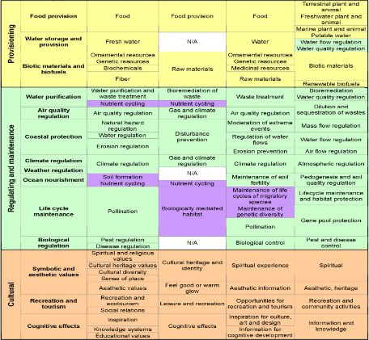
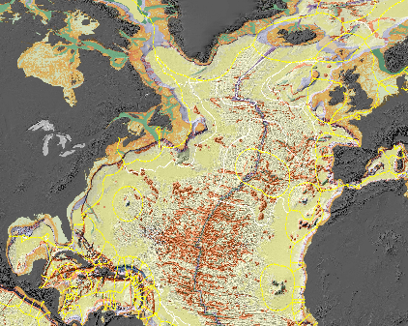
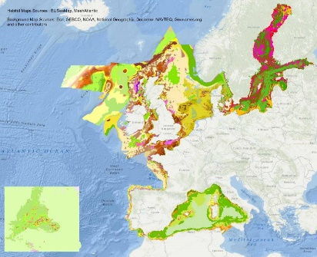
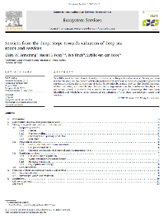
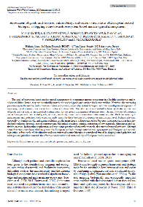
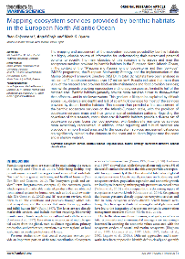
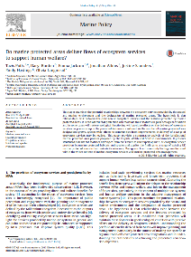

PRIORITIES
Marine Ecosystem Services
DISTRIBUTION AND QUANTIFICATION
OF MARINE ECOSYSTEM SERVICES
Classification systems for habitats and ecosystem services
EUNIS development (Galparsoro et al., 2012)
Trans-Atlantic habitat translation/harmonisation
Hierarchical or non-hierarchical approach? CMECS?
Marine Ecosystem Services review (Liquete et al., 2013)
Data collation
Seabed broad-scale data available from:
UNEP Global Seafloor Geomorphic Features Map
EUSeaMap, EUSeaMap 2, MeshAtlantic
Need to complete deep-sea and offshore areas
Marine Ecosystem Service inventory per habitat
Compilations available from e.g., Galparsoro et al. (2014),
Potts et al. (2013), Armstrong et al. (2012), Salomidi et al. (2012),
Millennium Ecosystem Assessment (2005)
Need to continue completing the inventory and updating

Slide 3
IMPLEMENTATION MEASURES
Marine Ecosystem Services
Habitat classification
Harmonize approaches: EUNIS, CMECS
Also important: establish North Atlantic Biogeographic boundaries (seabed and pelagic domains)
Data collation
Merge and compile further harmonised seabed and pelagic habitat occurrences
Also important: define spatial scale, minimum mapping unit, data aggregation rules
Habitat mapping
Segment the seafloor and the water-column in habitat classes
Also important: analysis of satellite imagery and oceanographic models to localize consistent regimes; spatially-explicit predictive models)
Marine Ecosystem Services inventory
Inventory CICES Ecosystem Services associated to each habitat (relationship likely specific to biogeographic region)
Also important: Review CICES (strengthen marine perspective)
Ecosystem Service mapping
Link habitat maps and information on ecosystem services provided by each habitat to map distribution of ecosystem services
Also important: Quantify and model natural provision rates and anthropogenic demand scenarios to assess sustainability and define management (service-specific models)

