Slide 1




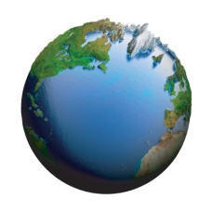

Ireland’s Marine Mapping Programme & Atlantic Priorities
Koen Verbruggen
Geological Survey of Ireland
Atlantic Mapping Workshop
Dublin Castle, Dec 2nd, 2014

Slide 2
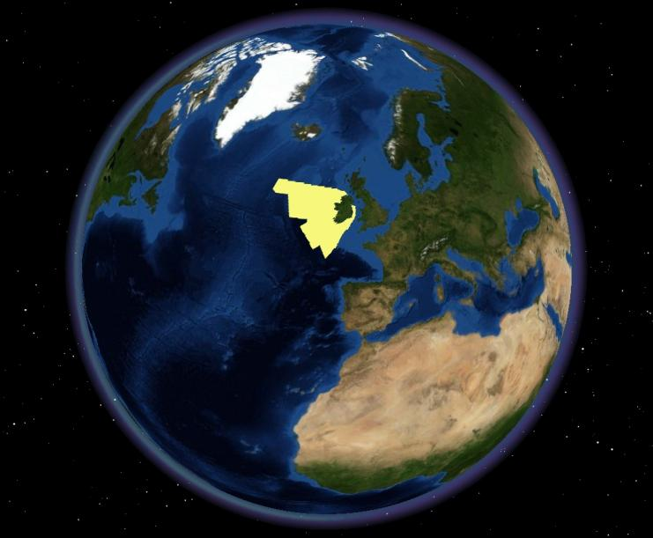
Who are we?

Slide 3
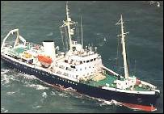
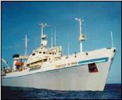
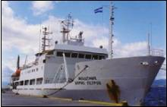
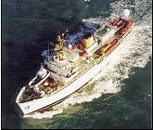
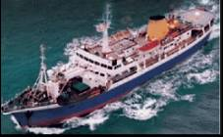
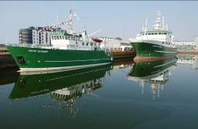
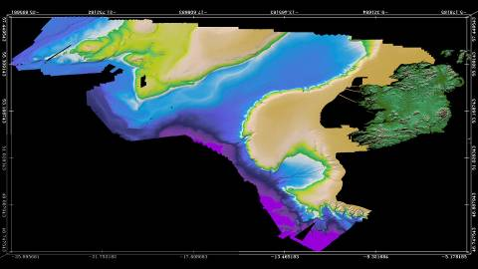


Irish National Seabed Survey (INSS) 1999-2005
Zone 3 fleet:
S.V. Bligh
S.V. Siren
CIL Granuaile
R.V Akademic Boris Petrov
R.V Professor Logachev
R.V. Ocean Seeker
R.V. Celtic Explorer
R.V. Celtic Voyager
The INSS established an essential national asset:
A marine BASELINE DATA set to underpin present and future Irish economic, environmental, infrastructural and policy decisions
Upgraded Irish marine surveying infrastructure
The body of knowledge required to design, procure, build and operate a large Exclusive Economic Zone (EEZ) survey
MAPPED ALL OUR WATERS OVER 200m DEEP!
Notes:
The INSS established an essential national asset:
A Marine BASELINE DATA set
Bathymetry
Gravity
Magnetics
Pinger
Sediment Samples
Seismic (reflection & refraction)
ROV

Slide 4
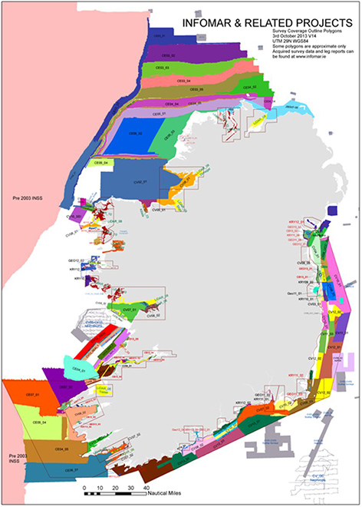


INFOMAR 2006-2026
  INtegrated Mapping
  FOr the Sustainable
  Development of Ireland’s
  MARine Resource
  “Shallow” water survey
  Partnership between MI & GSI
  Multi platform survey for marine
  integrated mapping
  Phase 1: 26 Priority Bays / 3 Priority Areas
INSS 1999- 2005 €32m US$41m C$42m
INFOMAR 2006-2014 €32m US$41m C$42m
Total to date €64m US$82m C$84m
Notes:
4

Slide 5
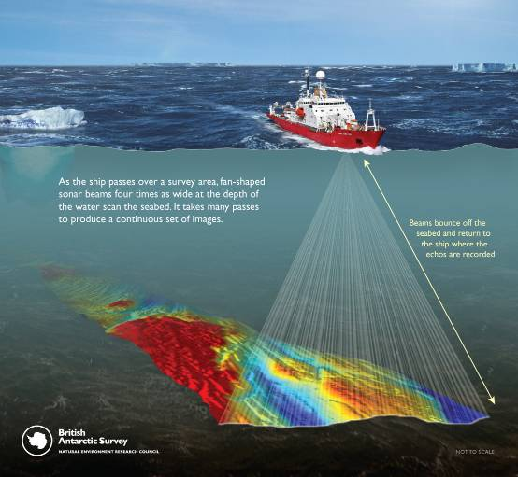
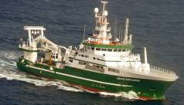
3 Key Priorities
  1.Data Acquisition, Management & Interpretation
  Accurate Multibeam Bathymetry & Backscatter & derived products
  2. Data Exchange & Integration
  Data must be freely available in appropriate formats
  3. Value Added Exploitation
  3rd party developers
  SME collaboration
  Application development
  Research Programmes
The Key Priorities of INFOMAR
Are equally valid for Atlantic Project

Slide 6

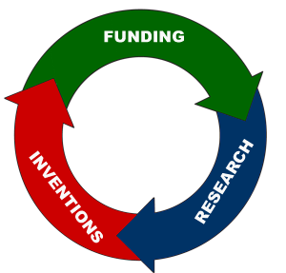
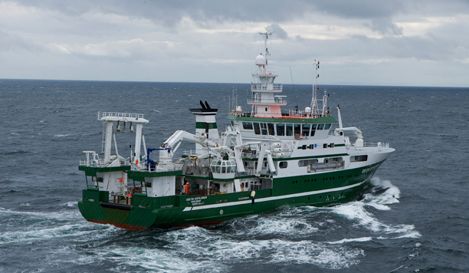
Implementation Measures
  1.Data Acquisition, Management & Interpretation
  National contributions of ship time & Expertise
  2. Data Exchange & Integration
  Common Atlantic Mapping Protocols & Web platform for data sharing
  3. Value Added Exploitation
  Targeted Research & Development Funding
&
=
&

Slide 7
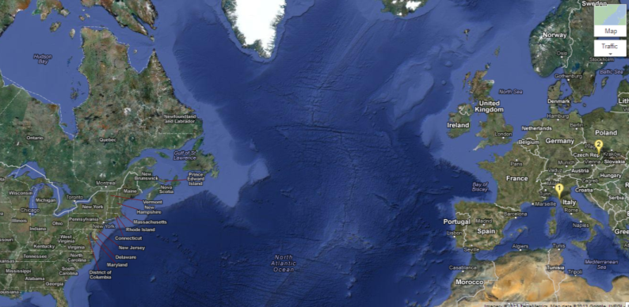
Real Map of the Atlantic

